Slide 1

W02D1
Introduction to SQL
Instructor: Samuel Boylan

Slide 2
Outline for today
Context and landscape (40 mins)
Demo of simple queries
Filtering, ordering, limiting, etc.
Joining tables
Grouping records
Aggregate functions
Notes:
Pretty deep into SQL. How do you feel about it and weekend exercises?
Warning: material later today will cover more advanced topics and it might seem like it’s going very fast at first. Windowing and Analytical Dataset queries (stretch) will look confusing at first. Don’t get discouraged, try and break the queries from the tutorials down into their subparts and try them out first so that you know what every part of the query does. You have all the tools to understand the concepts, just don’t be intimidated by the sheer size of the queries.
Easier kinds of queries that we’re covering in lecture and that you covered over the weekend are more important for our purposes, unless you have a database-heavy job. They’re the foundations of SQL that you should remember.
Use today’s lecture as a review to make sure you understand the foundations very well. Try to participate and think of the answers yourselves, since you will be on your own later today for the more difficult parts.

Slide 3
Why databases?
Enforce strict structure and relationships (forces you to keep data clean)
Makes it easier to train Machine Learning algorithms
Store massive amounts of data
Efficient retrieval of data
Centralized, secure, robust (another compute resource)
Integration with other software tools (e.g. Python)
*A company cannot be managed with Excel spreadsheets*
Notes:
The advantages come into clear focus when you think about how quickly things would get out of hand if a company attempted to manage data with Excel.
Consistency (e.g. number types vs. string types appearing in the same spreadsheet).
Size. Lack of efficiency. Not well organized, basically have to use a single massive table.
Speed. Operations like filtering, grouping, arithmetic are all slow and difficult to do. Bad for retrieval and manipulation.
Decentralized. Everyone starts making their own copy, who knows which is the true master file anymore.
Concurrency.
Google Spreadsheets can handle those, but run into other issues.
Excel has some integration with Python, but your Excel sheet has to be very specifically formatted. Easy for it not to work.

Slide 4
Why SQL?
NoSQL databases
Most common format for data storage/retrieval in enterprise
Still most proficient tool to investigate, filter, slice, and dice your data
Stored in formats other than relational tables, or retrieved in other ways
MongoDB (JSON-like): https://www.mongodb.com/nosql-explained
Notes:
MongoDB can be less efficient in terms of database size for equivalent information, but much more flexible (can easily evolve as the company needs evolve). Don’t need to spend as much time designing the database.
Example of when I was at ModiFace.
MongoDB stores in JSON-like format and provides a query language for efficiently retrieving information (i.e. no annoying indexing of nested structure like you had to do in API exercises).

Slide 5
Why are we learning SQL?
Internal database querying
May contain information you don’t want
May want to train your model on combinations/aggregations of fields from various tables
Data exploration through simple operations on different groups/subsets
Better understand transformations on data
Mentioned in almost every data science job posting
Data science jobs ask for a ton of skills, good to have exposure to all for interview purposes, even if they won’t all realistically be necessary
Notes:
For your midterm miniproject, the entire database will be too large for you to load in memory and train your model on.

Slide 6
Challenges when writing SQL
Declarative (SQL) vs. imperative (Python). Basically, no control flow
Long, nested queries with many variable names
vs. imperative programming where good programs break logic up into multiple steps
Many things happening concurrently in a single statement, order not explicit
vs. imperative programming where code executes line-by-line
Debugging is more difficult due to the above
Can help to break a complex query down into steps and test those out first. Incremental approach to writing the query
To review the fundamentals: https://www.w3schools.com/sql/

Slide 7
Database schemas
How do the different tables relate to each other?
Arguably most difficult part of relational databases is designing the schema
Less of a concern for data scientists—not our job!
For our purposes, useful to understand table structure of a database to know how to write our queries (e.g. what tables to join)
Common design principles
Star schema
Snowflake schema

Slide 8
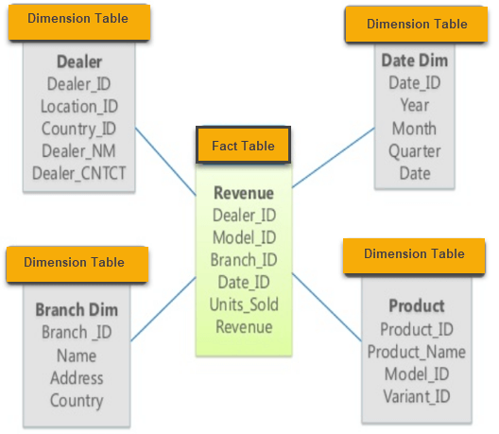
Star schema
Every concept represented by a single dimension table
Dimension table contains set of attributes
Dimension tables are related to a fact table using a foreign key
Dimension tables are not related to each other
Fact table contains key and measure
Notes:
Labels here signify columns within each table. Not showing any rows here, but image that there were many.
Think of the dimension tables as the structures describing entities/concepts in the database. What are their attributes?
Think of the fact table as relating all the entities to each other. Which entities occur together during a given event, such as a transaction?

Slide 9
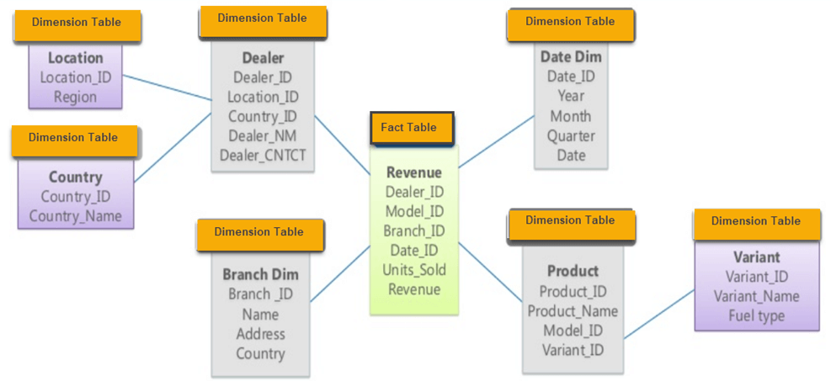
Snowflake schema
Nested version of star
Dimension’s attributes can also be complex concepts
Make dedicated tables for the sub-concepts and reference with foreign key
Normalized (efficient, non-repeating) database
Notes:
Three rules of normalization (i.e. most efficient form of data storage, ideal SQL database schema):
Eliminate repeating groups in individual tables.
Create a separate table for each set of related data.
Identify each set of related data with a primary key.

Slide 10
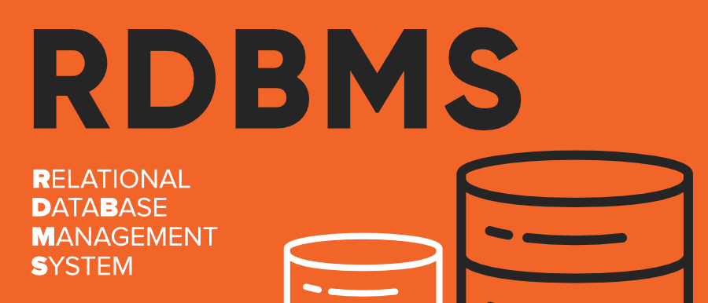
RDBMS Landscape
SQL is a programming language. A RDBMS stores data, converts SQL queries to database operations, controls security access, etc.
Closed source (i.e. paid)
Vendors: Oracle, SQL Server (Microsoft), IBM DB2, Microsoft Access - local small databases
Could come with integrations and services that make things easier
Open source
MySQL, PostgreSQL, SQLite, MariaDB
Good developer community makes these great options
This website offers a good comparison of open source systems options.
Notes:
Mention closed source advantage primarily integration. Example of me at Orbis

Slide 11
Why SQLite?
Not directly comparable to client/server SQL database engines such as MySQL, Oracle, PostgreSQL, or SQL Server
Used as on-disk file format for desktop applications
No concurrency (can’t have multiple users accessing simultaneously)
Great to learn on to get a hang of SQL

Slide 12
Why PostgreSQL (postgres)?
Open source nature makes it easy to upgrade or extend
High compliance to the SQL standard
Easily runs on Windows, Mac OS X, and almost all Linux distributions
MySQL would be a good choice too (less compliance to SQL standard)
Uses psql to make/interact with databases (terminal application)

Slide 13
Demo
https://github.com/moeraza/light-house-labs/tree/main/w02d01

Slide 14
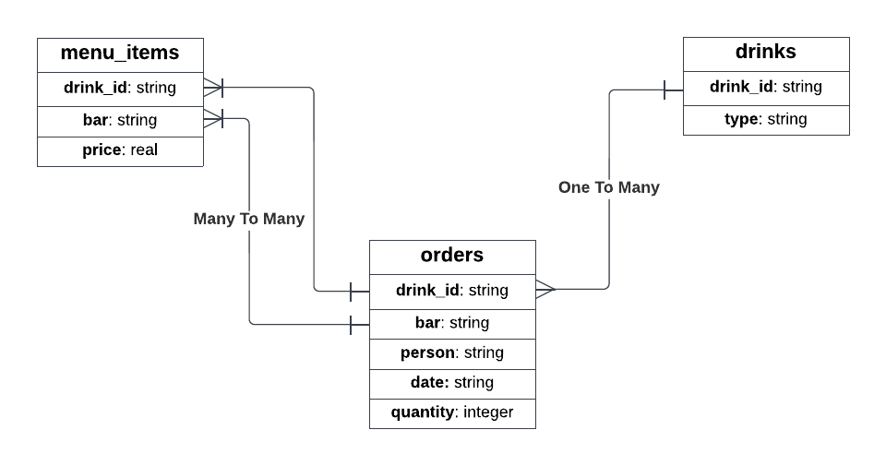
Drinks Schema

